Slide 1


Learning and Development Management Application
This presentation explores the development of a comprehensive learning and development management application. We'll delve into the project's key features, technical aspects, and future plans.
by samriddhi gupta

Slide 2
User Authentication and Role Management
Secure Access
Role-Based Permissions
Centralized User Management
Ensuring only authorized users can access the application.
Granting different user groups access to specific features.
Streamlining user creation, updates, and account management.

Slide 3
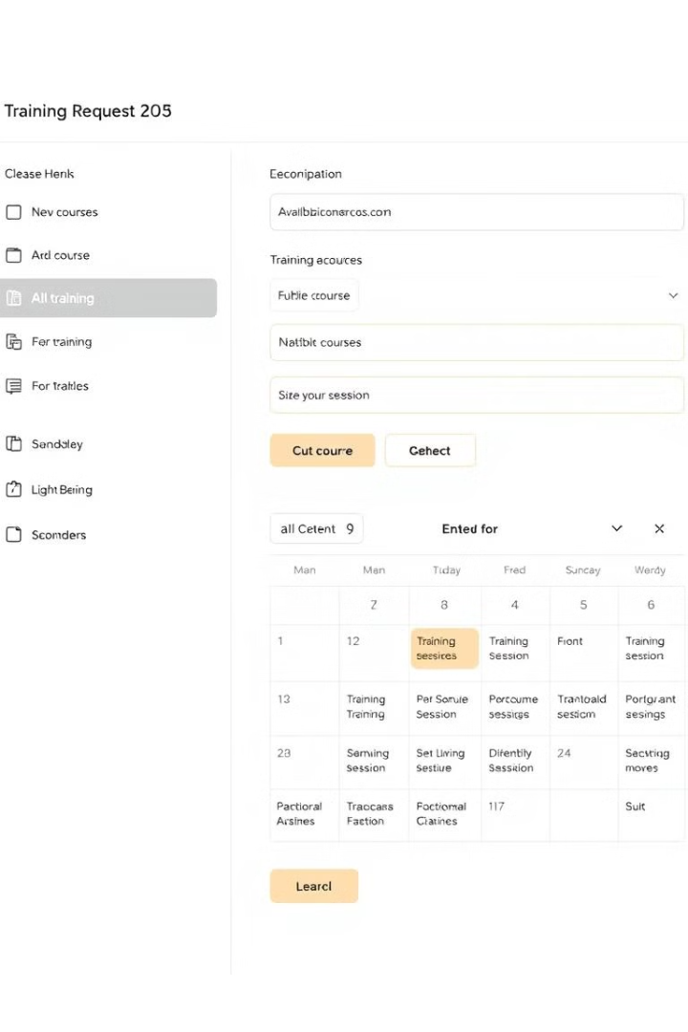
Training Request and Course Management
Course Catalog
Request Management
Central repository of available courses for users to browse and request.
Streamlining the process of submitting, reviewing, and approving training requests.
Course Scheduling
Scheduling and tracking course delivery and attendance.

Slide 4
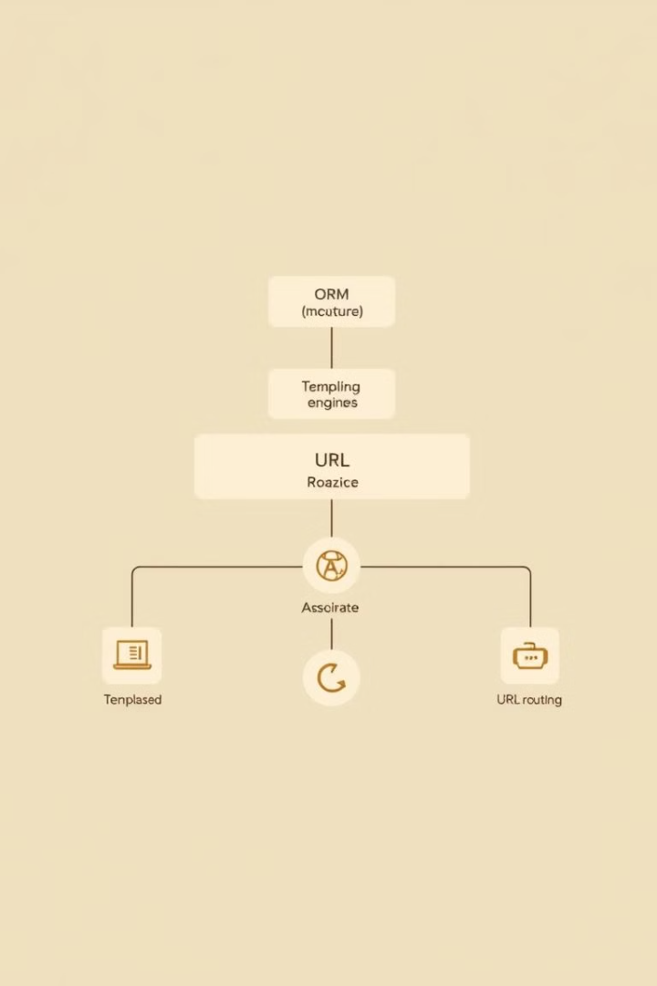
Django Web Framework
Python-Based
Built-in Features
Leveraging the power of Python for backend development.
Comprehensive set of features for web development.

Slide 5




HTML and CSS for Frontend
User Experience
Responsive Design
Accessibility
Ensuring a user-friendly and intuitive interface for all users.
Adapting to different screen sizes and devices.
Making the application accessible to users with disabilities.

Slide 6
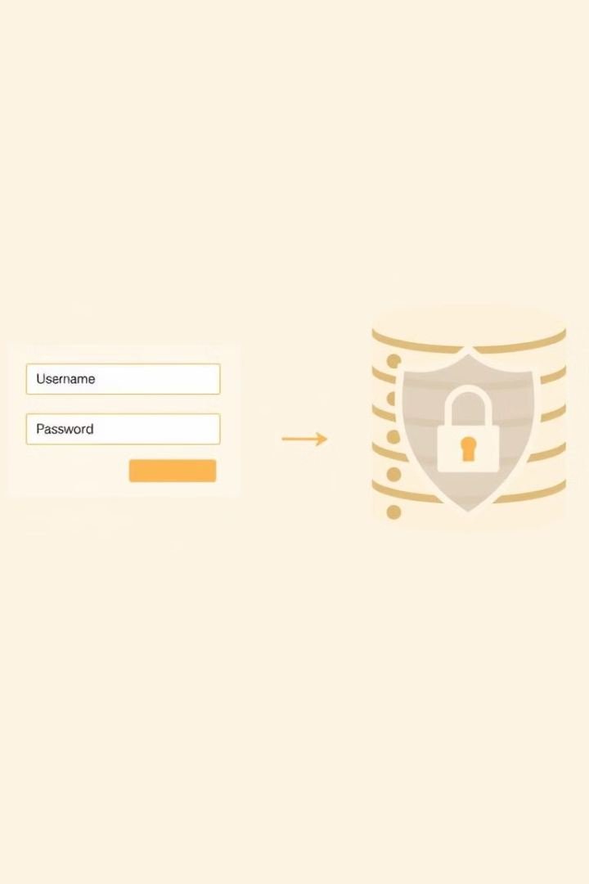
Backend Development: User Login and Signup
1
User Input Validation
2
Data Hashing and Salting
3
Session Management and Authentication

Slide 7




Upcoming Features: Training Request and Course Management
Course Search
Filtering and sorting courses based on criteria.
Course Feedback
Collecting user feedback on course quality.
Completion Tracking
Monitoring user progress and completion of courses.

Slide 8

Project Conclusion and Next Steps
The development of the Learning and Development Management Application is progressing well. We are focused on building a robust platform for managing training programs, with a clear focus on scalability, security, and user experience. Upcoming features will continue to expand the functionality of the application, making it an essential tool for training and development initiatives.

